Slide 1


Face Recognition Based Password Encryption and Decryption System
Presented By
Tejasree Kilari-811241145

Slide 2

About the Paper:
The Paper is published by Sawant, Vedant A.; Vishwas, Swarup D.; Giri, Rakshanda A.; Shingote, Akshay D.; Joglekar, Pushkar. S In: 2023 4th International Conference for Emerging Technology (INCET).
The URL for the Paper is https://ieeexplore-ieee-org.proxy.library.kent.edu/stamp/stamp.jsp?tp=&arnumber=10170090&isnumber=10169900.

Slide 3
Introduction:
The proposed system provides a secure and convenient way for users to authenticate their identity and transmit data using facial recognition technology and AES encryption algorithms.
The goal is to help users maintain their passwords with a password card that contains the website's address and its encrypted password.

Slide 4
Literature review:
Paper 1: Face Detection and Attribute Recognition using Deep Learning: Heavy reliance on labeled training data may limit performance.
Paper 2: Face Recognition Algorithm utilizing OpenCV and Encryption: Lack of discussion on capturing multiple angles may reduce accuracy.
Paper 3: AES-based Password Encryption Model : Doesn't include user identification methods like facial recognition for enhanced security.
Paper 4: Hardware Implementation of AES Algorithm : Hardware requirements not specified for implementation.

Slide 5
Algorithms Used:
HAAR Cascade Algorithm
Advanced Encryption Standard Algorithm
Local Binary Patterns (LBP) for face recognition.
These algorithms are used for better performance and achieving the goals .

Slide 6

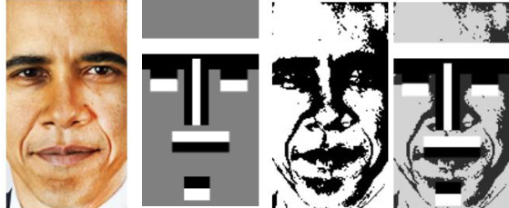


Haar Cascade Classifier for face detection:
In context of the proposed system, the Haar Cascade classifier is utilized for face detection.
To determine the features that differentiate between faces and non-faces, the algorithm is trained on a set of positive and negative photos.
A cascade of classifiers that can precisely identify faces in fresh photos or video frames is constructed using these features.
User Enrollment Module :The user creates an account by entering their name and phone number and authorizes access to the camera for picture capture as part of the user registration

Slide 7
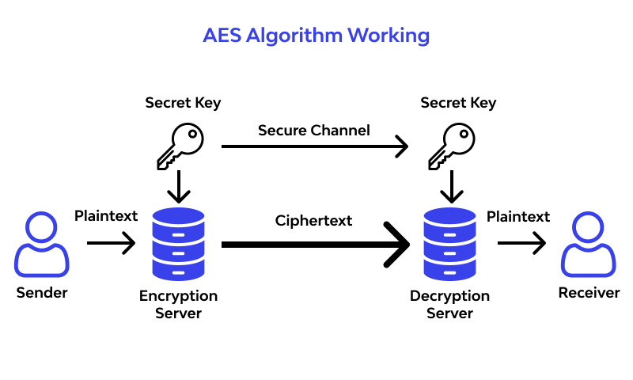
Advanced Encryption Standard:
The proposed system uses AES encryption to protect user data at a high level, preventing unauthorized access to confidential data.
AES encryption and face recognition work together to create a powerful two-factor authentication system, substantially boosting the system's security.
The AES algorithm ensures the secrecy and integrity of user.

Slide 8
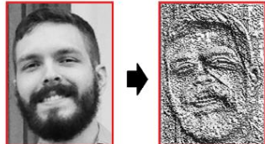
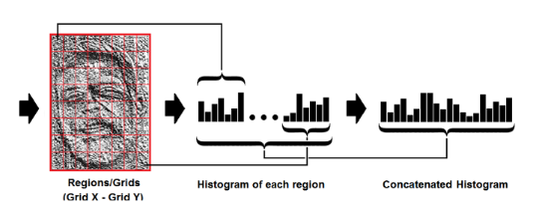
Local Binary Patterns (LBP) for face recognition:
Local Binary Patterns (LBP) algorithm is used to recognize users’ identity. The LBP algorithm extracts features from the face image and represents them as binary patterns.
These patterns are then compared with previously saved patterns to verify the identity of the user.
If their face is recognized in more than 5 images, the system decrypts the password and allows the user to view it. This module ensures that only the authorized user can access their encrypted password.

Slide 9
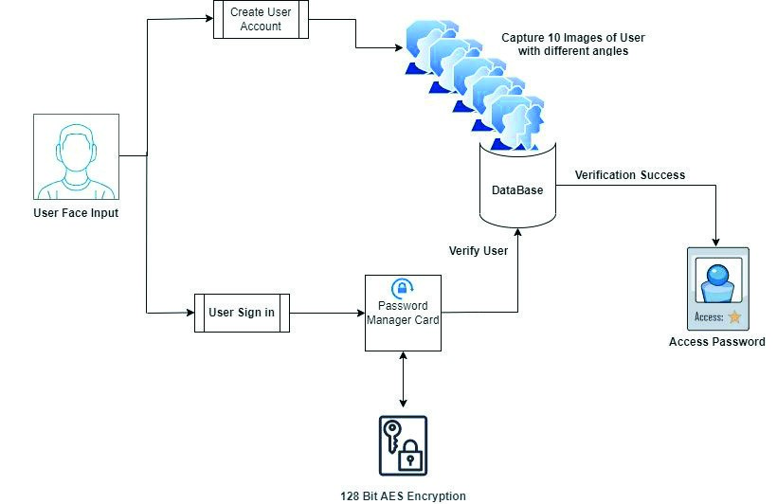
Working :
During registration, users input their details and allow camera access for image capture. The system captures ten facial images and employs the "Haar Cascade Classifier" algorithm to authenticate users by recognizing their faces, storing images where the user's face is recognized in more than five instances.
The Password Creation and Encryption Module enables users to securely encrypt website URLs and passwords using the Advanced Encryption Standard (AES) algorithm. Encrypted keys are generated for passwords, updating the system's database while providing users with encrypted password cards. For secure data transmission, the Password Decryption and Transmission Module decrypts passwords using AES decryption techniques.
User authentication during login involves facial recognition and comparison with saved images, ensuring access only for authorized users.

Slide 10


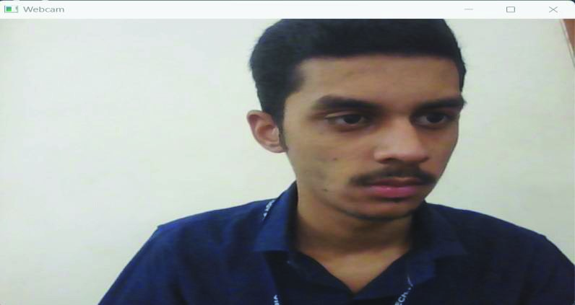

Results:
A.
Snapshots of System
Fig.5.Sign Up Page

Slide 11
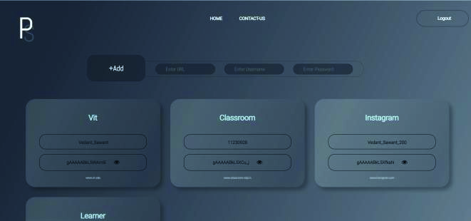


Results:
Fig.10.User Recognized Correctly

Slide 12
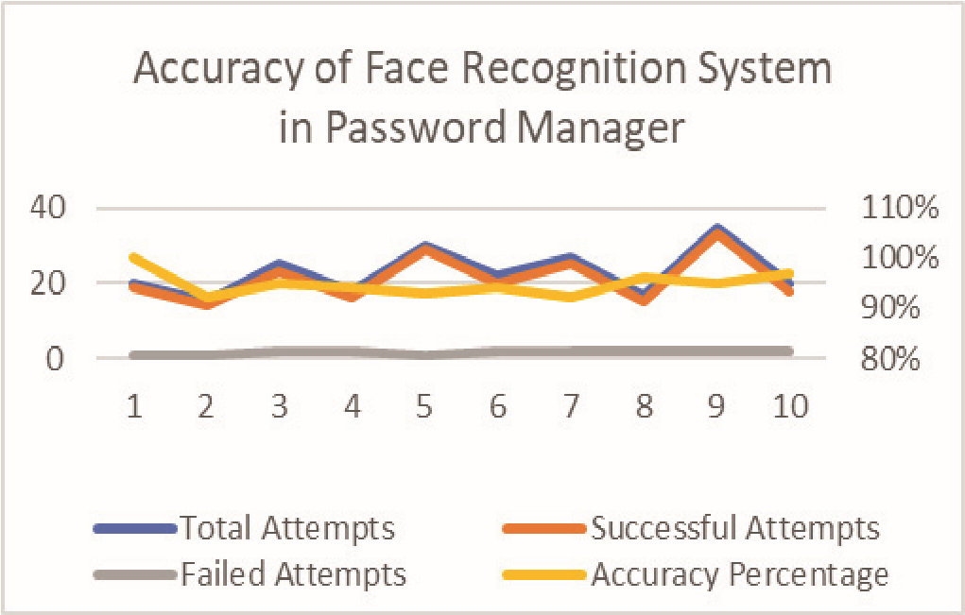
The system's overall performance was quite good, with a 95% accuracy rate in identifying the user's face for authentication. 50 tests were conducted in total, and 47 of them were effective in identifying the user's face and granting access to the system. While the system occasionally failed to recognize the user's face in low light during testing under various lighting scenarios, this was an uncommon occurrence.
Fig.12.System Accuracy Graph

Slide 13
Advantages :
Achieved a high accuracy rate of 95% in identifying user faces for authentication.
Maintains robust data security with no recorded instances of unauthorized access.
Successfully combines AES encryption and facial recognition for enhanced security and user authentication.
Provides a secure and user-friendly environment for managing passwords and accessing sensitive information

Slide 14
Conclusion:
Using face recognition technology, the suggested system offers a safe and effective method of managing passwords.
The password card system offers a safe and practical way to store and access passwords.
Multi-factor authentication can be added to the system to make it even more secure, and the user interface can be made more user-friendly and intuitive. The creation of this system has the potential to revolutionize password administration and give users a safer, easier experience.

Slide 15

Thank you

